Slide 1


International Conference on Civil Judgment: Contemporary Challenges in e-Enforcement
Examples of Best Practices in e-Auction
SPEAKER:
VIKRAM NAIR
SESSSION FIVE 12 JULY 2022
1

Slide 2

Presentation Agenda
01
Sheriff’s Auctions in Singapore
02
e-Lelong in Malaysia
Vikram Nair
Deputy Head
Partner
Commercial Litigation
03
Considerations for e-Auctions
2

Slide 3

Sheriff’s auctions in singapore
3

Slide 4
Sheriff’s Auctions in Singapore
Seized assets are auctioned by sheriff in Singapore.
Typically, a third-party auctioneer will be appointed to conduct auction.
Auctions are still generally done physically at an auction venue.
Information about auctions is published online and in newspapers.
4
Notes:
Internal: Order 22 r 7 of the Rules of Court 2021 provides as follows:
(4) Where the value of the seized property is estimated by the Sheriff to be $20,000 or less, the sale may be conducted by the Sheriff and may be by private treaty or by public auction.
(5) Where the value of the seized property is estimated by the Sheriff to be more than $20,000, the sale must be conducted by an auctioneer and by public auction.
(6) Notice of sale of seized property stating the day, time and place of sale must —(a) be given on the Sheriff’s Internet website as specified in the practice directions; or (b) be posted at the place of intended sale, at least 14 days before the date of sale.
(7) All sales of immovable property must be conducted by an auctioneer and by public auction.
(8) Notice of sale of immovable property stating day, time and place of sale must be advertised by the auctioneer at least once in a printed local newspaper and at least 14 days before the date of auction.

Slide 5
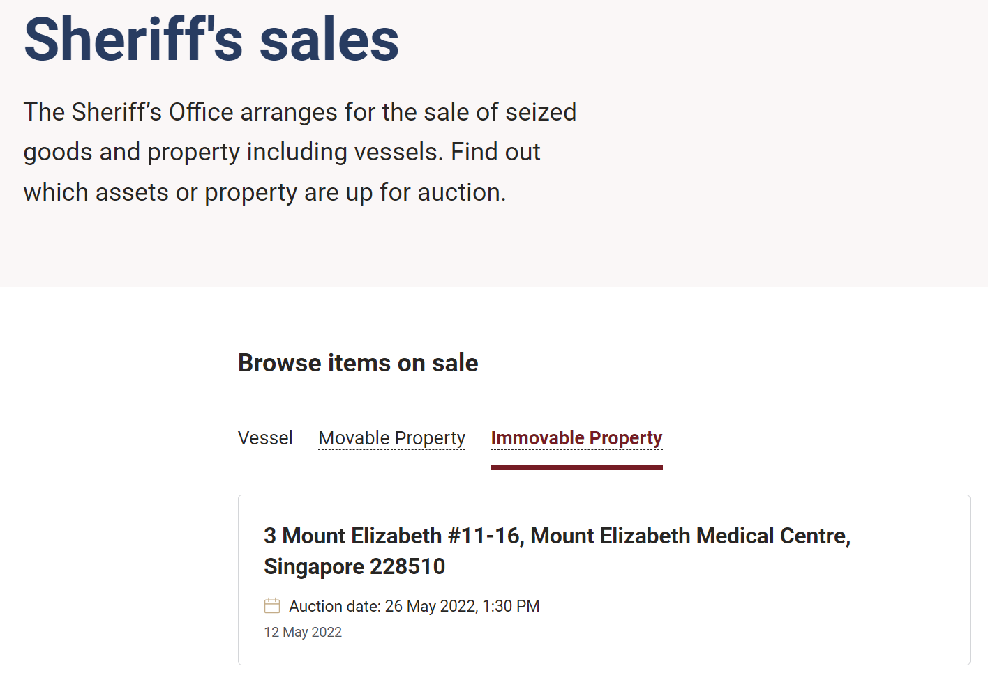
Sheriff’s Auctions in Singapore
Example of Sheriff’s sale advertised on Singapore judiciary website:
5

Slide 6

                E-lelong system in malaysia
6

Slide 7
e-Lelong in Malaysia
Real time e-bidding for immovable property
Bidder must register, but identity is kept confidential.
A deposit equal to 10% of reserve price must be provided.
3 public auction sessions everyday, for maximum of 1 hour each.
No auctioneer needed.
7
Notes:
No need to appear in Court as the public auction is being conducted online in real time
Bidders can check particulars of the property they want to bid on with details and thoroughly
Searches of auctioned properties can be conducted more easily and widely

Slide 8

Considerations for e-auctions
8

Slide 9
Considerations for e-Auctions
Accessibility of online platform.
Verifying identity of bidders.
Security of payment.
Security of data.
Opportunity for buyers to do due diligence on properties.
Hybrid auctions?
9

Slide 10

Q&A

