Slide 1
INTERNATIONAL CONFERENCE – BANGKOK – 2022

Slide 2
Example of Best Practices in e-Auction
The Belgian example
Patrick Gielen
Secretary of the Board UIHJ
12th July 2022
INTERNATIONAL CONFERENCE – BANGKOK – 2022

Slide 3
INTRODUCTION
INTERNATIONAL CONFERENCE – BANGKOK – 2022

Slide 4
Introduction
Judicial auction of movable goods
Judicial officers
In physics to date
Judicial auction of immovable goods
Notaries
BIDDIT (online) since 01.09.2018
INTERNATIONAL CONFERENCE – BANGKOK – 2022

Slide 5
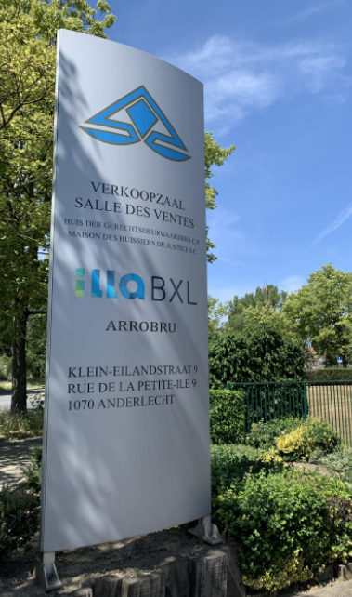
Present situation
Physical sales
Every week
For every district (13)
Physical presence of each judicial officer who carried out the seizure
LONG - NOT VERY EFFICIENT - NO FLEXIBILITY - LOW BIDDING VALUE
INTERNATIONAL CONFERENCE – BANGKOK – 2022

Slide 6
Legislation
Articles 1516, 1522 and 1526 of the Belgian Judicial Code (law 05.05.19)
Royal Decree: 28.11.2021 (M.B. 30.11.21)
Terms and conditions
Ministerial Decree: 29.11.2021 (M.B. 08.12.21)
Fees
General conditions in the process of being finalized
Name of the platform : « auctionline » (www.auctionline.be)
ONLINE : SEPTEMBER 2022
INTERNATIONAL CONFERENCE – BANGKOK – 2022

Slide 7
JUDICIAL ELECTRONIC AUCTION
INTERNATIONAL CONFERENCE – BANGKOK – 2022

Slide 8
ANNOUNCEMENT OF THE AUCTION
Secure national central register for judicial public auctions (= platform)
Location of the auction
The nature of the goods for sale
The name of the Judicial Officer
The specific conditions of sale
INTERNATIONAL CONFERENCE – BANGKOK – 2022

Slide 9
THE ONLINE AUCTION
Platform
Manager : CNHB
Limited access to :
CNHB
Judicial Officer
(applicant) buyer
INTERNATIONAL CONFERENCE – BANGKOK – 2022

Slide 10
THE ONLINE AUCTION
Registration
Natural person / legal entity
Authentication
Required data ?
INTERNATIONAL CONFERENCE – BANGKOK – 2022

Slide 11
THE ONLINE AUCTION
Conduct of the auction
Only online
Start and end of the sale (+ possibility of extension)
Mixed / combined : online and in the auction room
Start of the sale and day of physical auction
Amount of the sale
Address and period to view the goods physically
Fee : 7,5%
INTERNATIONAL CONFERENCE – BANGKOK – 2022

Slide 12
THE ONLINE AUCTION
Adjudication
Highest bid
Electronic notice
Item
Amount to be paid
Information
Consequences in case of non-payment
Judicial officer
Resolves the problems
Draws up the adjudication report
INTERNATIONAL CONFERENCE – BANGKOK – 2022

Slide 13
THE ONLINE AUCTION
Payment
Before the deadline
Online
INTERNATIONAL CONFERENCE – BANGKOK – 2022

Slide 14
CONCLUSION
INTERNATIONAL CONFERENCE – BANGKOK – 2022

Slide 15
CONCLUSION
Simple and efficient system
Quick set up with Covid
Manager = CNHB
Flexible system
INTERNATIONAL CONFERENCE – BANGKOK – 2022

Slide 16
Thank you for your attention
Patrick Gielen
p.gielen@uihj.com
INTERNATIONAL CONFERENCE – BANGKOK – 2022

