Slide 1


International Conference on Civil Judgment: Contemporary Challenges in e-Enforcement
Awareness of other laws and regulations related to e-Enforcement
SPEAKER:
VIKRAM NAIR
PLENARY SESSSION TWO
12 JULY 2022

Slide 2

Presentation Agenda
01
Enforcement of Judgments in Singapore
Considerations for Enforcement Orders – Creditor’s Perspective
02
Considerations for Enforcement Orders – Debtor’s Rights
03
Vikram Nair
Deputy Head, Disputes
Partner
Commercial Litigation
04
Processes that are electronic
05
Digital Enforcement Code
06
Digital Enforcement Code – Application in Singapore
2

Slide 3
Enforcement of Judgments in Singapore
e-Enforcement of court orders is limited in Singapore
Current enforcement tools include:
  Examination of judgment debtor – To identify debtor’s assets
  Enforcement orders against judgment debtor’s property: (a) seizure and sale; (b) delivery or possession; (c) attachment of debt owed to judgment debtor; and (d) do "anything specified in the court order”.
  Equitable execution (?) – Appointment of receiver to collect judgment debtor’s equitable interests
  Bankruptcy / insolvency proceedings against judgment debtor
Notes:
Enforcement orders – O 22 r 2 ROC 2021
Equitable execution – Previously available under O 51 ROC 2014 but not specified provision in ROC 2021, but probably still available in principle. New ROC 2021 has a provision for appointment of receivers at O 13 r 9 – that is parked under the interim relief section though language provides for appointment of receiver at any time where appropriate, which is wide enough to cover the enforcement stage.

Slide 4
Considerations for Enforcement Orders – Creditor’s Perspective
Chance of recovery – What and where are the debtor’s assets?
Costs of recovery
Expedience – Targeted approach
Proportionate enforcement
4

Slide 5
Considerations for Enforcement Orders – Debtor’s Rights
Proper service of process
Debtor (and third-party holder of debtor’s assets)’s right to be heard
Enforcement must be proportionate to debt

Slide 6
Processes that are electronic
Digital extraction / verification of court orders – Authentic Court Orders (ACO) system (https://www.courtorders.gov.sg/)
Authorised third parties will have access to e-court orders
Authentication and service of court orders simplified
6

Slide 7
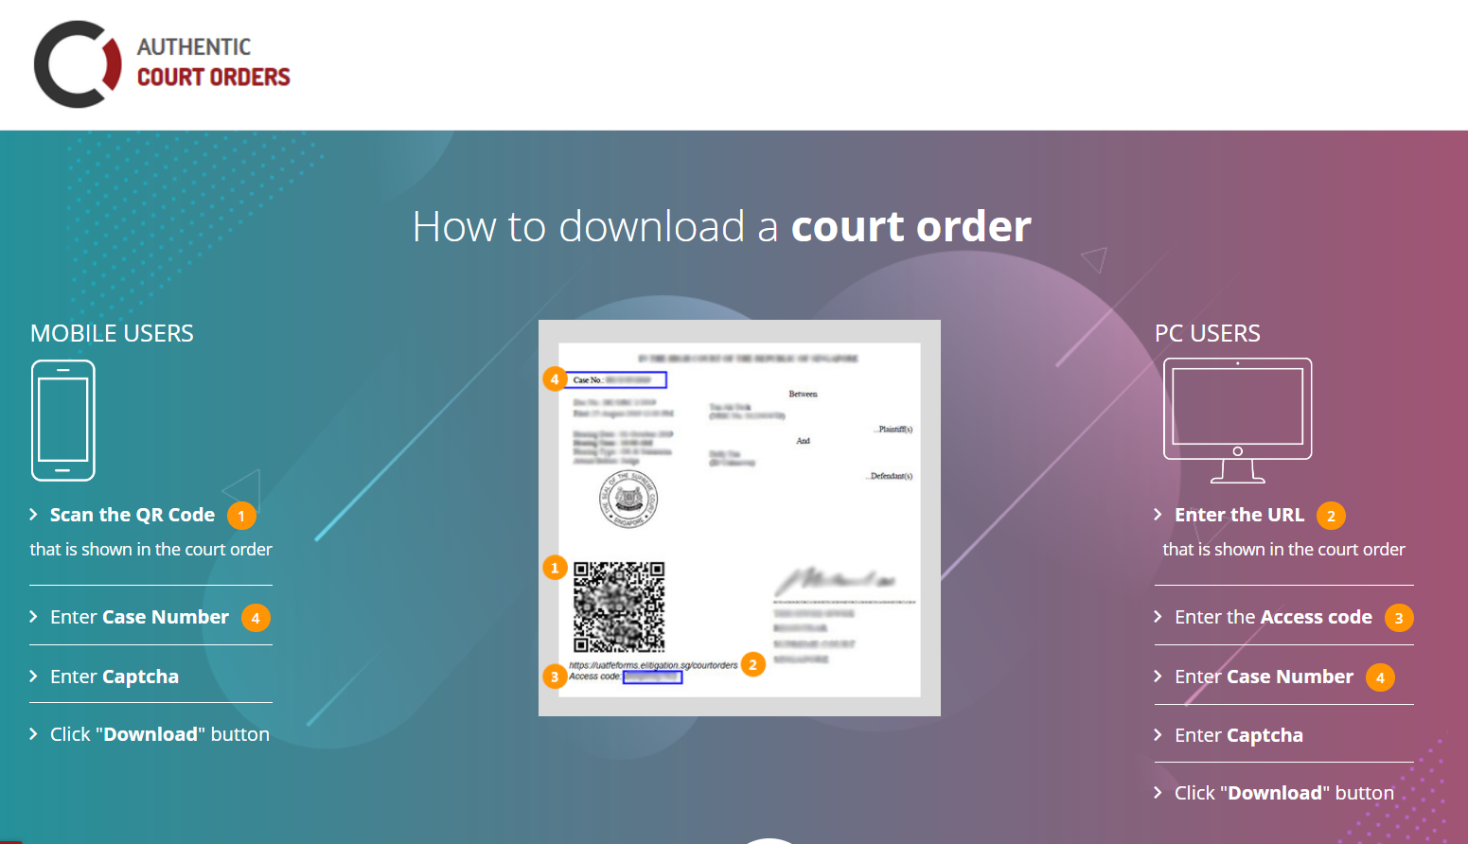

Slide 8
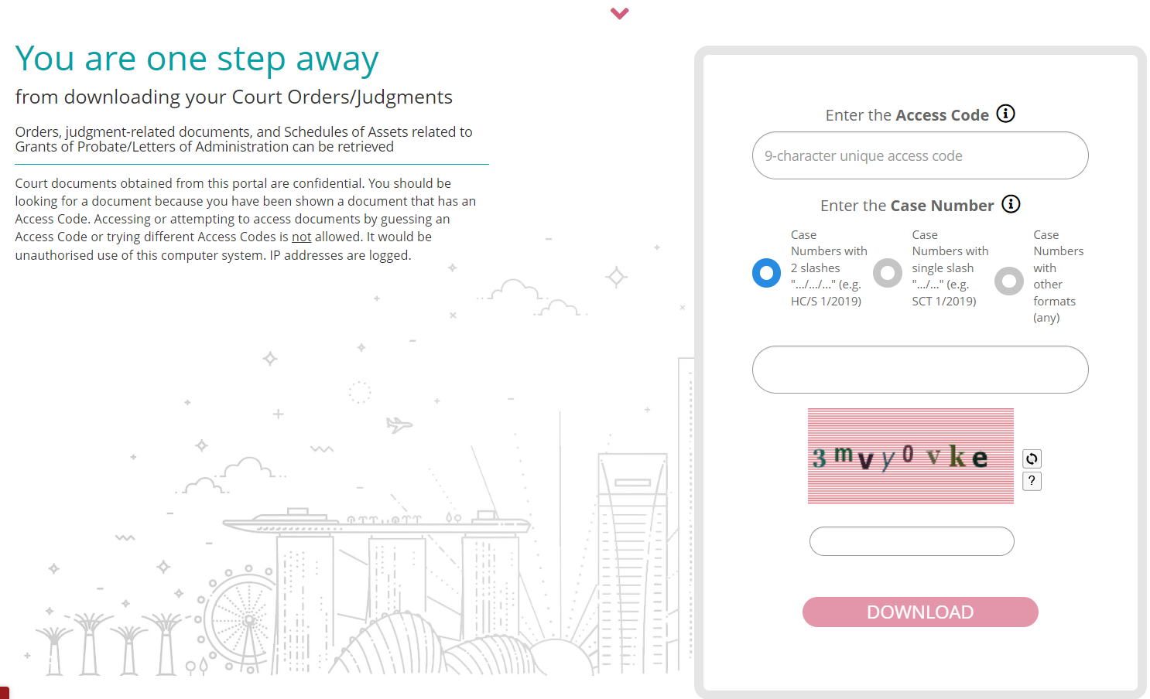
8

Slide 9
Digital Enforcement Code
Promulgated by the International Union of Judicial Officers.
General principles regarding digital enforcement including (a) ethical principles for use of technology to aid enforcement; (b) respect for fundamental human rights
Conflicts of law principles regarding digital enforcement – seizure of digital assets to be compliant with the law of the place the assets are situated.

Slide 10
Digital Enforcement Code
Rules governing enforcement agents’ use of digital tools for enforcement, including access to information on debtor’s assets.
Rules governing the procedure for digital enforcement and for seizure of digital assets.
Use of artificial intelligence in enforcement.
Seizure of crypto-assets – there are recommendations for the creation of a national crypto-assets register, and imposition of obligations on debtors to declare their crypto assets.

Slide 11
Digital Enforcement Code: Application in Singapore
Singapore permits seizure of crypto-assets – “Movable property” that can be subject to enforcement orders defined to include cryptocurrency or other digital currency.
No formal legislation/judgment adopting other points in Digital Enforcement Code but principles applied, eg:
  (a) proportionality (Article 4);
  (b) debtor / third party obliged to comply with enforcement order (Articles 7, 9);
Notes:
ROC 2021 O 22 r 1 – Defines “movable property” as including cryptocurrency or other digital currency

Slide 12
Digital Enforcement Code: Application in Singapore
No formal legislation/judgment adopting other points in Digital Enforcement Code but principles applied, eg:
  (c) debtor’s / third party’s right to set aside enforcement orders (Articles 5-7);
  (d) conflict of laws principles – law of the location of the assets (Article 11);
  (e) seizure of digital and crypto-assets – (Articles 39-57)
Notes:
ROC 2021 O 22 r 1 – Defines “movable property” as including cryptocurrency or other digital currency

Slide 13

Q&A

